Slide 1
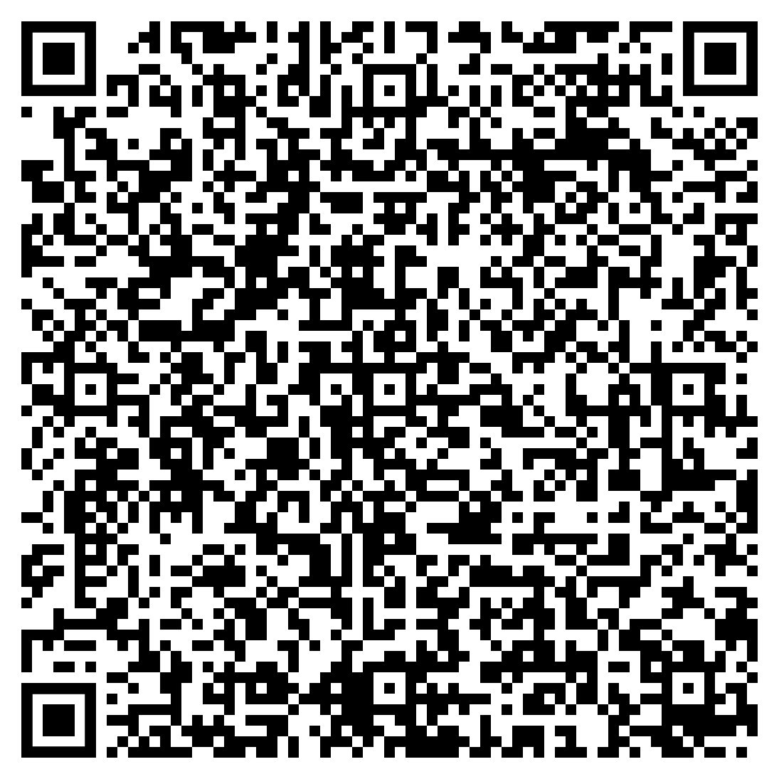


CEA Data Breach Exposes Info of 3,000+ Exam Registrants
CEA’s Data Breach
Caused by IT Glitch
Who were the victim(s)?
The Council for Estate Agencies (CEA) is a regulatory body overseeing Singapore’s real estate industry. It has in its information system the personal information of its salespersons and individuals who registered for exams with them.
What happened?
A technical issue in the CEA's information system resulted in data leaks of over 3,000 registered users. The exposed data included full names and NRIC numbers of individuals who had registered for the March 2024 real estate salesperson examination and the April 2024 real estate agency examination.
What is the Impact of the Incident?
The data breach compromised the privacy and security of affected individuals. Such exposure increases the risk of identity theft, misuse of personal data, and other fraudulent activities.
Date: Jan 29, 2025
Copyright © 2025 AgilenLite Pte Ltd
1
Notes:
https://www.straitstimes.com/singapore/over-3000-individuals-names-nric-numbers-leaked-due-to-ceas-it-system-error
Note: Actions taken by CEA
It has written to all affected individuals to inform them of the incident and its follow-up actions, and to apologise to them.
it immediately disabled the affected system function and launched a probe to identify the root cause.
“The IT system in which the issue occurred has since been secured, and recovery steps have been taken to contain it,” said CEA.
The agency added that it is reviewing its systems and processes with its vendor to prevent a recurrence.

